Slide 1
Self-Check Laboratory IV (Latches, Flip-Flops, & Registers)
Anthony Ramos
CSC343
Spring 2021

Slide 2
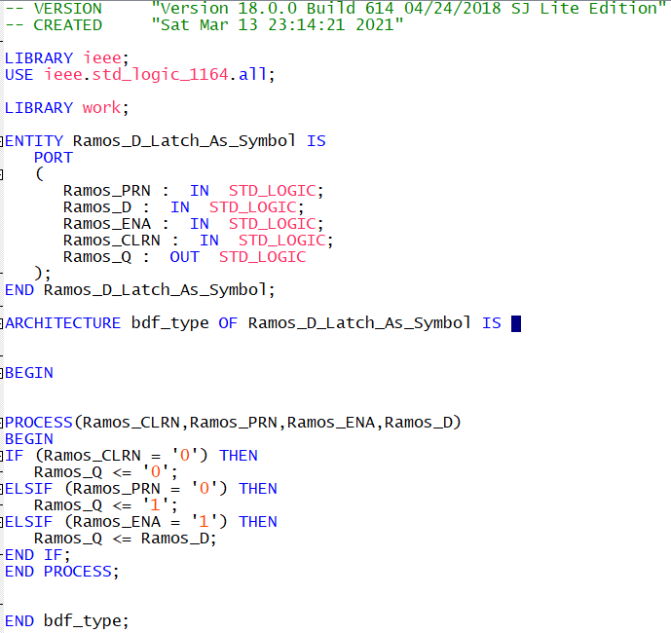
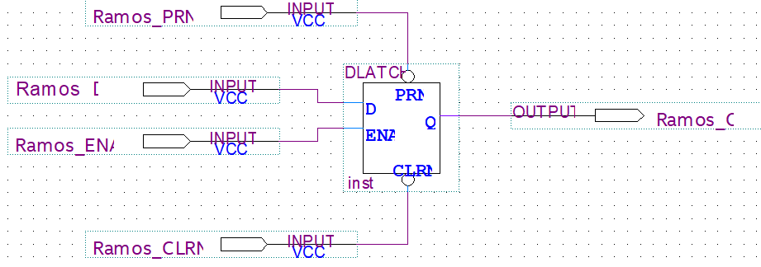
D-Latch (Symbol)
Clear (CLRN) – Set output to 0 if ‘0’
Preset (PRN) – Set output to 1 if ‘0’
Enable (ENA) – Allows for output to mirror input if set to ‘1’
Input (D)
Output (Q)

Slide 3
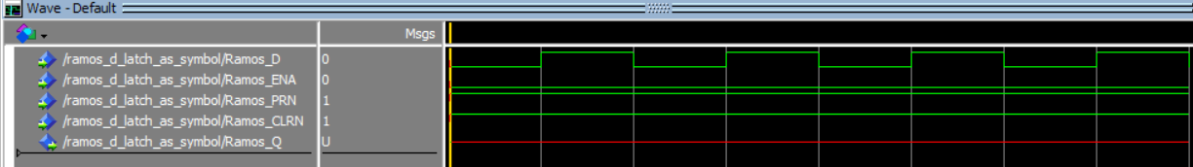
D-Latch (Symbol)
Simulation 1 shows the output Q remains undefined (red signal) regardless of input D because the Enable is always low (i.e. 0). Note that the PRN and CLRN signals are set to 1 which does not affect the output.
Figure: D-Latch Simulation 1

Slide 4
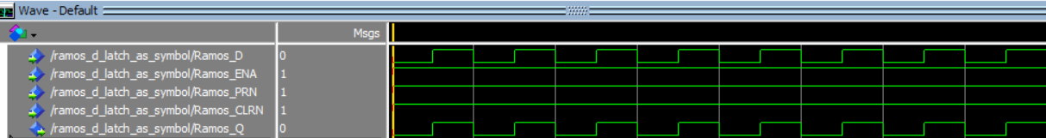
D-Latch (Symbol)
Simulation 2 shows the output Q remains mirrors the input D because the Enable is always high (i.e. 1). Note that the PRN and CLRN signals are set to 1 which does not affect the output.
Figure: D-Latch Simulation 2

Slide 5
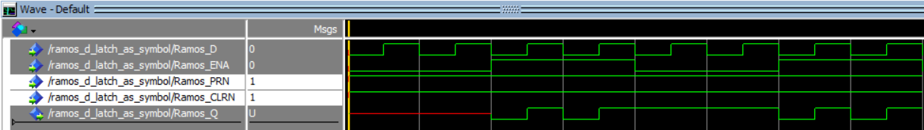
D-Latch (Symbol)
Stage 1
Stage 2
Stage 3
Stage 4
Simulation 3 shows the output Q remains undefined (red signal) for some time as the ENA signal is ‘0’ in Stage 1. Soon after, in Stage 2, the ENA signal is set to ‘1’ and so, output Q follows the behavior of input signal D. In Stage 3, the ENA signal is set to ‘0’ again and so the output remains (freezes) in its last known state (i.e. ‘1’). When ENA signal is ‘1’ again, the output once again follows signal D in Stage 4.
Figure: D-Latch Simulation 3

Slide 6
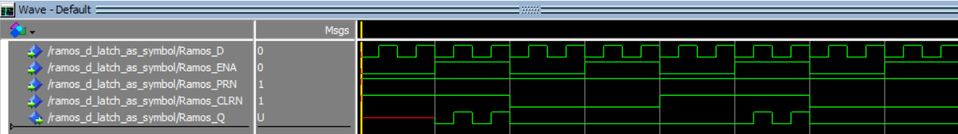
D-Latch (Symbol)
Stage 1
Stage 2
Stage 3
Stage 4
Simulation 4 shows the output Q remains undefined (red signal) for some time as the ENA signal is ‘0’ in Stage 1. Soon after, in Stage 2, the ENA signal is set to ‘1’ and so, output Q follows the behavior of input signal D. In Stage 3, The ENA signal is then ‘0’ and rather than ‘freezing’ the output Q, Q goes to ‘0’ because the CLRN signal is set to ‘0’. When the CLRN signal is set to ‘1’ in Stage 4, the output Q remains ‘frozen’ if the ENA signal is ‘0’. If the ENA signal is ‘1’, the output once again follows the behavior of the D signal. Note that if we set PRN to 0 (not shown in this simulation), Q would have jumped to ‘1’ instead.
Figure: D-Latch Simulation 4

Slide 7
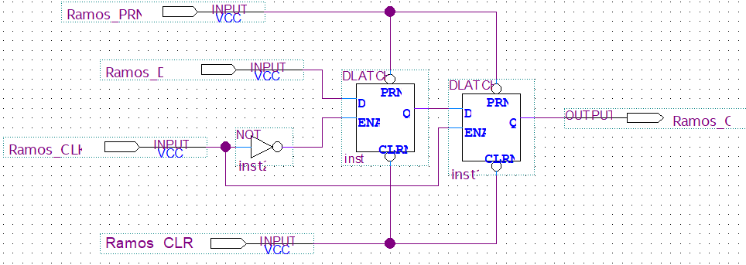
Master-Slave D Flip-Flop

Slide 8
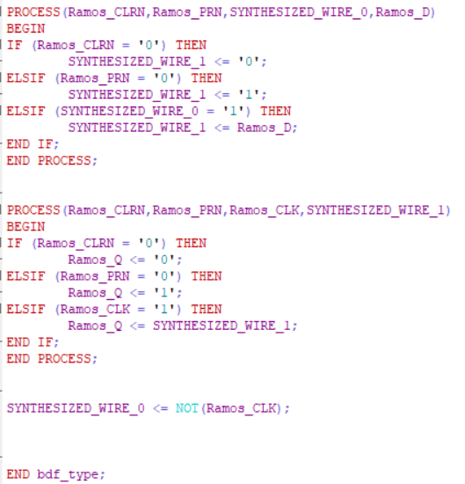
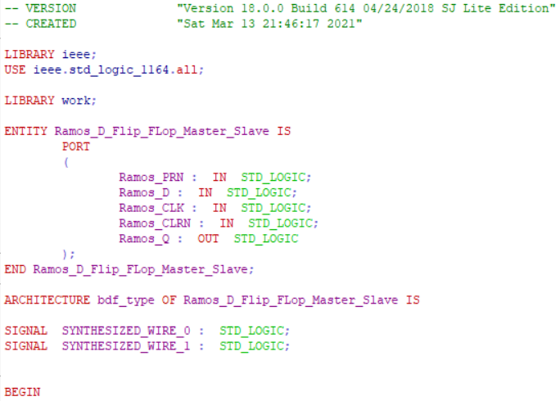
Master-Slave D Flip-Flop

Slide 9
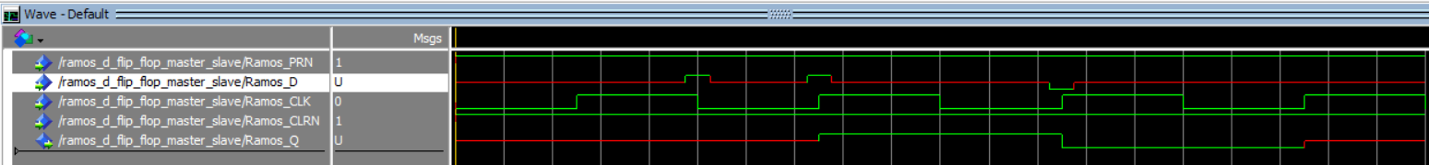
Master-Slave D Flip-Flop
Stage 1
Stage 2
Stage 3
Initially, in Stage 1, the output Q remains undefined (red signal). In Stage 2, the output then mirrors signal D at the rising edge of the CLK. The Q value remains frozen for some time and follows D again at the rising edge of the CLK and remains frozen until the next rising edge. At the last rising edge (Stage 3), D is undefined and so Q is also undefined. Note that PRN and CLRN are set to ‘1’ as to not affect the output in any way.
Figure: D-Flip Flop Simulation

Slide 10
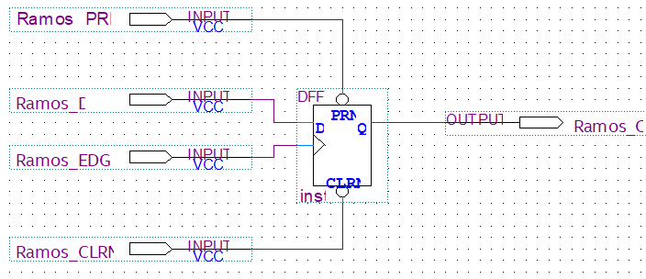
Master-Slave D Flip-Flop (Symbol)

Slide 11
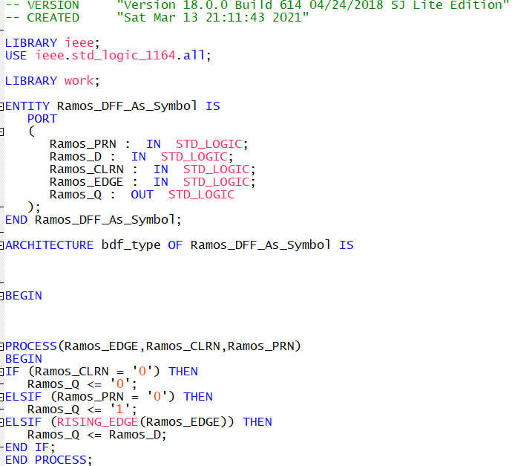
Master-Slave D Flip-Flop (Symbol)

Slide 12
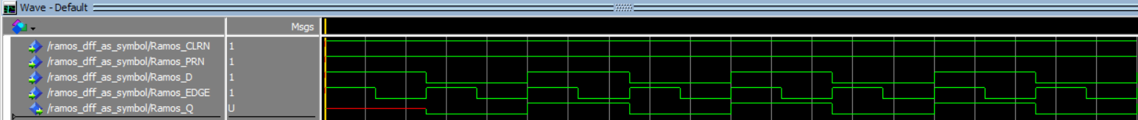
Master-Slave D Flip-Flop (Symbol)
Stage 1
Stage 2
Initially, in Stage 1, the output Q remains undefined (red signal). In Stage 2, the output then mirrors signal D at the rising edge of each clock pulse (CLK). The Q value remains frozen for some time and follows D again at the rising edge of the CLK. This process simply repeats. Note that PRN and CLRN are set to ‘1’ as to not affect the output in any way. This matches the behavior of the previous design using two D-Latches.
Figure: D-Flip Flop (Symbol) Simulation

Slide 13
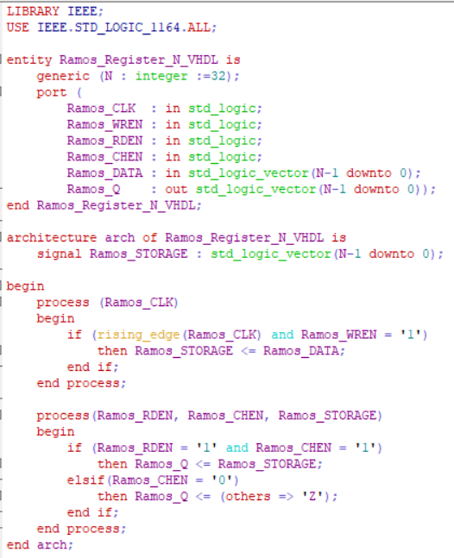
N-Bit Register
Clock Signal (CLK)
Write-Enable (WREN) – Change contents of stored data in register if ‘1’.
Read-Enable (RDEN) – Allows for stored data to be displayed on output only when ‘1’.
Chip-Enable (CHEN) – Will cause the output to be undefined if ‘0’
Data (DATA)
Output (Q)

Slide 14
N-Bit Register

Slide 15
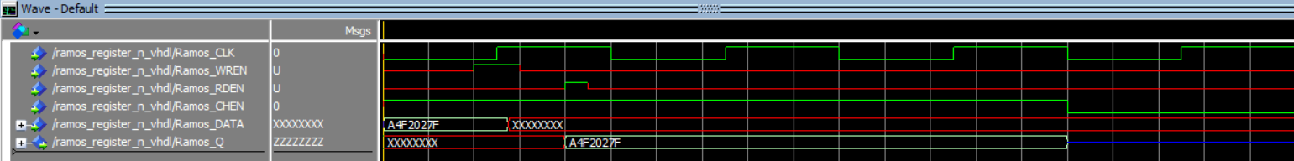
N-Bit Register
Stage 1
Stage 2
Stage 3
Initially, in Stage 1, the output Q remains undefined (red signal) as the DATA input with arbitrary value ‘A4F2027F’ is loaded into the storage space due to the WREN signal being ‘1’. In Stage 2, with the RDEN signal is set to ‘1’, the DATA is fed into the output Q. In Stage 3, the CHEN signal is set to ‘0’ which causes the output Q to be undefined “ZZZZZZZZ” (blue signal).
Figure: N-Bit Register Simulation 1

Slide 16
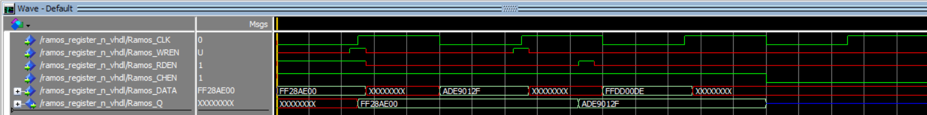
N-Bit Register
Stage 1
Stage 2
Stage 3
Stage 4
Initially, in Stage 1, the output Q remains undefined (red signal) as the DATA input with arbitrary value ‘FF28AE00’ is loaded into the storage space due to the WREN signal being ‘1’. In Stage 2, the output Q reads the DATA input despite
Figure: N-Bit Register Simulation 2

